Slide 1
Prototype lab flow
Sukhdeep Sehra

Slide 2
Introduction
PROPOSAL: A project that manages the flow of items entering in and leaving out of the prototype lab

Slide 3
budget
Total Cost = $198.85
Item | Make/Model | Description | Status | Quantity | Cost | Final Cost
Raspberry Pi | RPi3 Model B | Required to run the database server. | Acquired [from Starter kit] (www.raspberrypi.org/products/raspberry-pi-3-model-b) | 1
USB Webcam | Microsoft Lifecam HD-3000 | Required to read QR codes. | Purchased (www.amazon.ca/dp/B009VL9YJ2) | 1 | $35.99 | $40.67
Starter Kit | Raspberry Pi Starter Kit | AC Adapter and SD card required. Case is not necessary. | Purchased (www.amazon.ca/dp/B01CCF6V3A) | 1 | $99.99 | $112.98
PCB | Printed Circuit Board | A required a circuit to light up the L.E.D once the webcam scans a QR Code | Acquired (Humber Prototype Lab) | 1 | $40.00 | $45.20

Slide 4
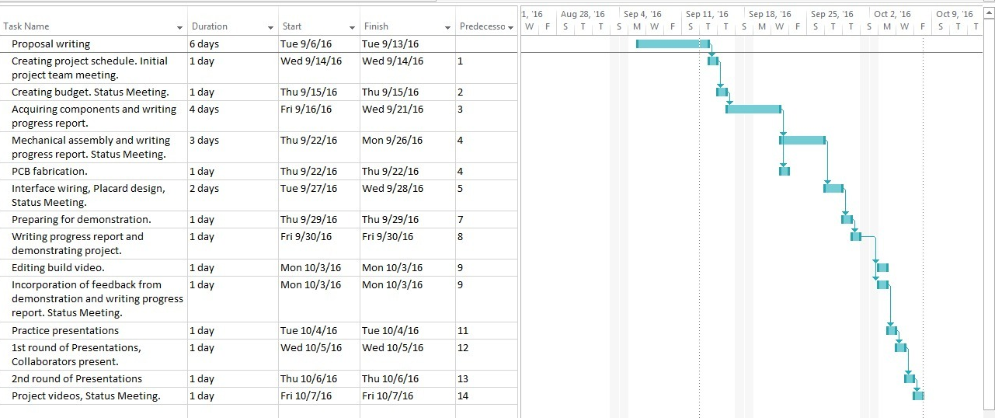
Project Schedule

Slide 5
build VIDEO
https://www.youtube.com/watch?v=QCVtIeCc8ks

Slide 6
Knowledge from previous courses
TECH 101 – Electric Circuits & TECH 150 – AC Circuits Building, designing, and testing circuits.
CENG 215 – Digital and Interfacing Systems Using logic to manipulate circuits for example led blinking.
CENG 216 – Intro to Software Engineering & WRIT 220 Gantt Chart and writing weekly progress reports.

